Slide 1


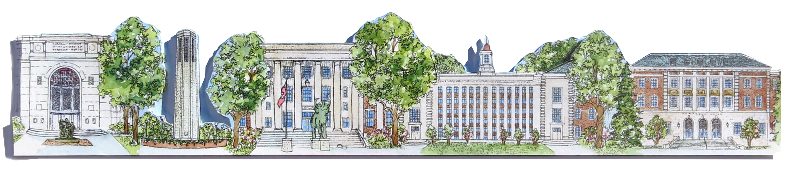
Nebraska
AgHack 2025
SURVIVAL GUIDE

Slide 2






Slide 3
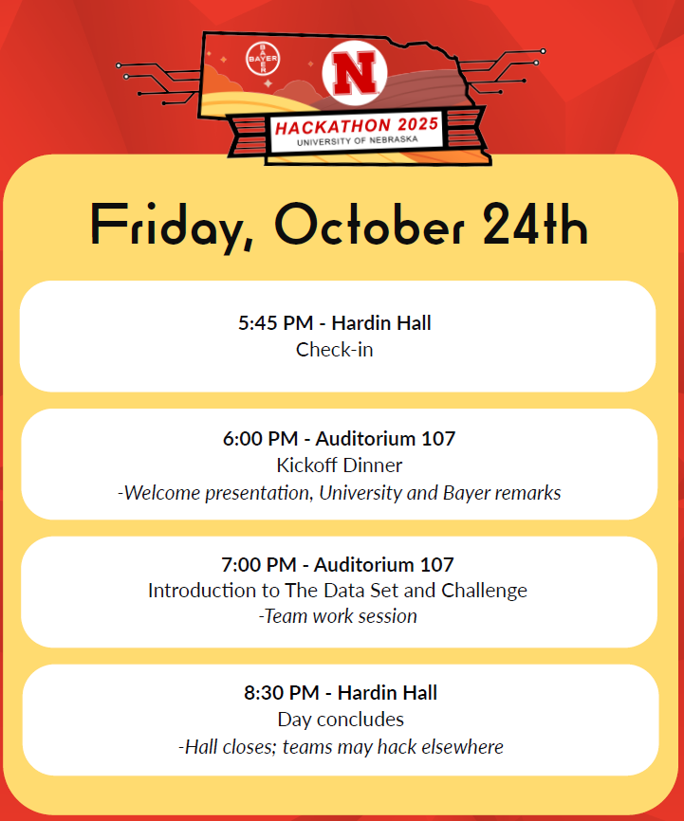
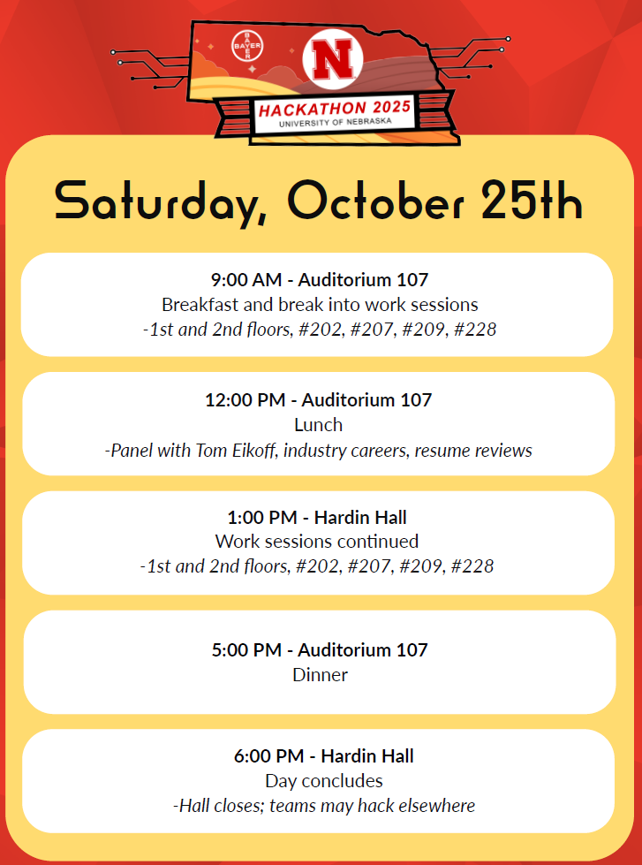
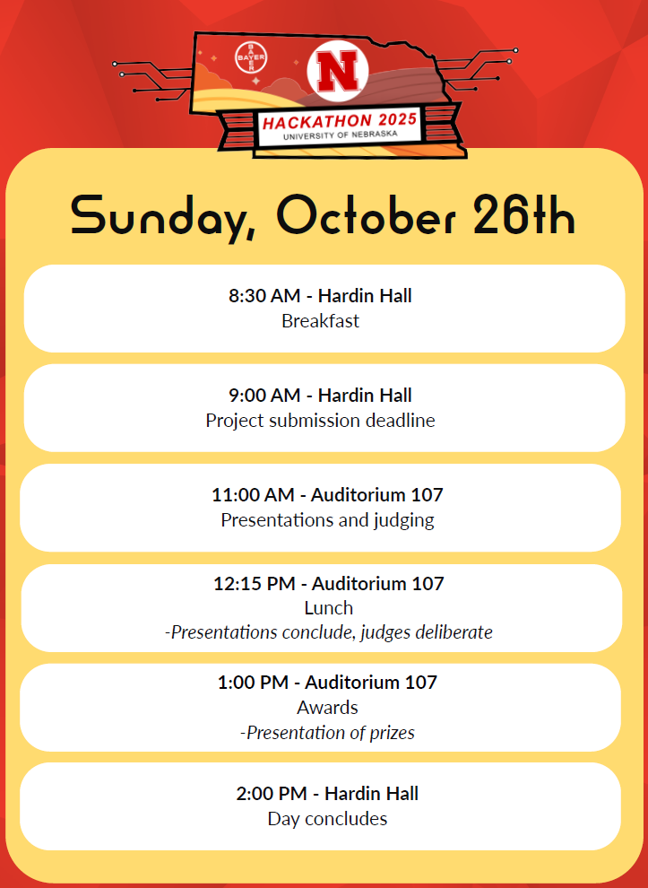

Slide 4
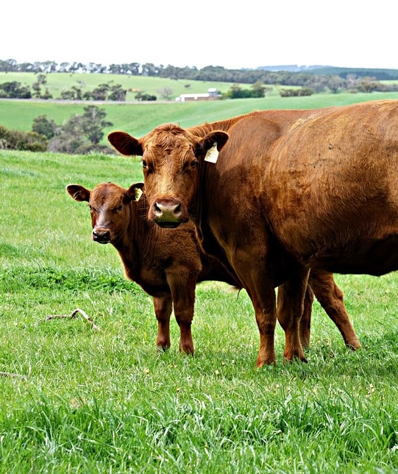
SELFIE CHALLENGE
Full Team Should be in the photo - You don’t have to take the photo yourself; someone can take it for you.
MAKE IT FUN
Post it on LinkedIn – Tag your team, repost and ask for comments! Tag @Bayer, @UNL, and the organizers (I am tracking)!
Include following taglines: #SelfieChallenge, #UNLAgTechHack2025
The most likes and comments for a photo wins, by Sunday at 10:00am!

Slide 5
MEET THE MENTORS

Slide 6


Slide 7


Slide 8


Slide 9


Slide 10


Slide 11


Slide 12


Slide 13


Slide 14


Slide 15


Slide 16
THANK YOU!
AND HAVE FUN!!!!!!!!!!

Slide 17
AGENDA
Friday
October 24, 2025
6:00pm – Welcome and Kick-Off
6:30pm – Prompt and Setup
8:00pm – Hackathon Begins
Saturday
October 25, 2025
8:30am - Hackathon Continues
12:00pm - Lunch
12:30pm – Lunch Presentation – Demetrius Bledsoe – Fresh365
6:00pm - Dinner
8:00pm - Continue hacking!
8:30am - Submissions are due
10:00am - Practice presentations
9:30am – Presentations Begin
11:00am - Judges Deliberation
11:45am - Prizes presentation and Winners announced
Sunday
April 7, 2024

